Slide 1
Canada Learning Bond
Notes:
Above is link to the Jess from St. Catharines video.

Slide 2
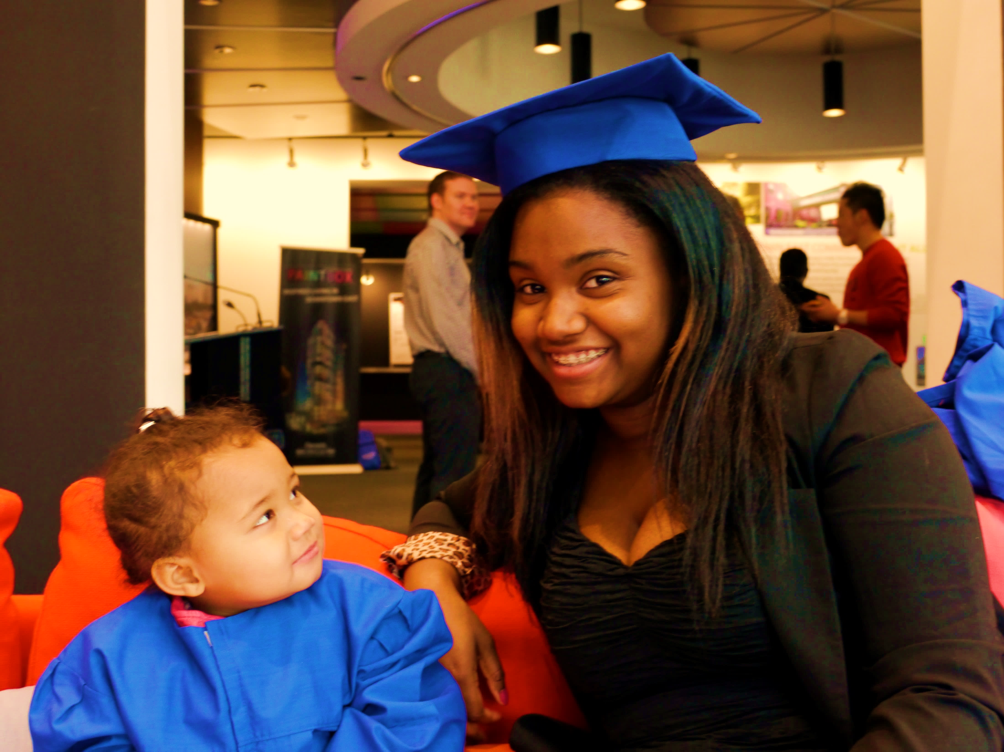
There are 20,863 eligible children in Niagara who are not receiving the $41,726,000 available to them for their post-secondary education.
Notes:
28,742 children in Niagara are eligible
If each eligible child was eligible for the full $2,000 this would mean $57,484,000 of federal funding for Niagara. Currently only receiving $15,758,000.
Means $41,726,000 is still available.
n children eligible for the Canada Learning Bond who aren’t receiving the $700 million+ available for their future education.
In Niagara as of March 2015:

Slide 3
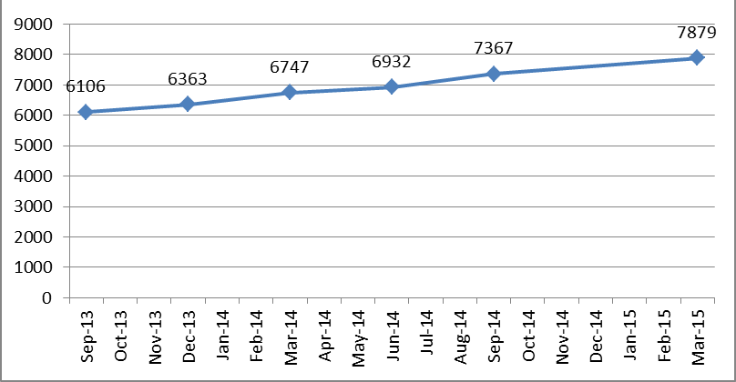
CANADA
LEARNING BOND
UP-TAKE RATE FOR NIAGARA
As of Mar-2015:
28,742 children in Niagara are eligible. Only 7,879 are receiving CLB.
20,863 children are eligible but not receiving CLB
Only 27.4% uptake in Niagara. Goal is 40% uptake by Dec-2016
If each eligible child is eligible for the full $2,000 this would mean $57,484,000 of federal funding for Niagara. Currently only receiving possibly $15,758,000. Means $41,726,000 is still available.
Notes:
As of Mar-2015:
28,742 children are eligible but not receiving CLB
Only 7,879 are receiving CLB.
Only 27.4% uptake in Niagara. Goal is 40% uptake by Dec-2016
If each eligible child is eligible for the full $2,000 this would mean $57,484,000 of federal funding for Niagara. Currently only receiving $15,758,000. Means $41,726,000 is still available.

Slide 4
Community Goal
We want to increase participation rate to
40% by December 2016.
As of March 31, 2015 CLB data shows that Niagara has a participation rate of only 27.4%.
Notes:
That means that only 7,879 of the 28,742 children eligible have received the benefits of the CLB program. The lowest uptake is in Port Colborne at 20.5% and the highest uptake is in Grimsby at 33.9%.

Slide 5
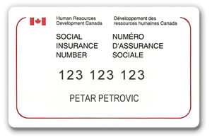
HELP FAMILIES
ENROL
January 2004 or later
< $44,701
Notes:
Help families navigate the enrolment process.
Help identify Bond eligibility – child born January 2004 or later and family’s net income is less than $44,701 in 2015
Primary caregiver and child both need a SIN #

Slide 6
CANADA LEARNING BOND
FEATURES
$0
No contribution required
Can be used for education after high school for up to 36 years
Retroactive
Notes:
The Government makes an initial deposit of $500, plus $100 each year of eligibility until the child reaches the age of 15, up to a maximum of $2,000.
The Government will only deposit the Bond into an RESP.
The grant is retroactive.
A family doesn’t need to make a single contribution to get the Bond.
The Bond can only be used toward post-secondary education.

Slide 7
CANADA LEARNING BOND REGISTRATION
Notes:
5 step process to register for a Canada Learning Bond

Slide 8
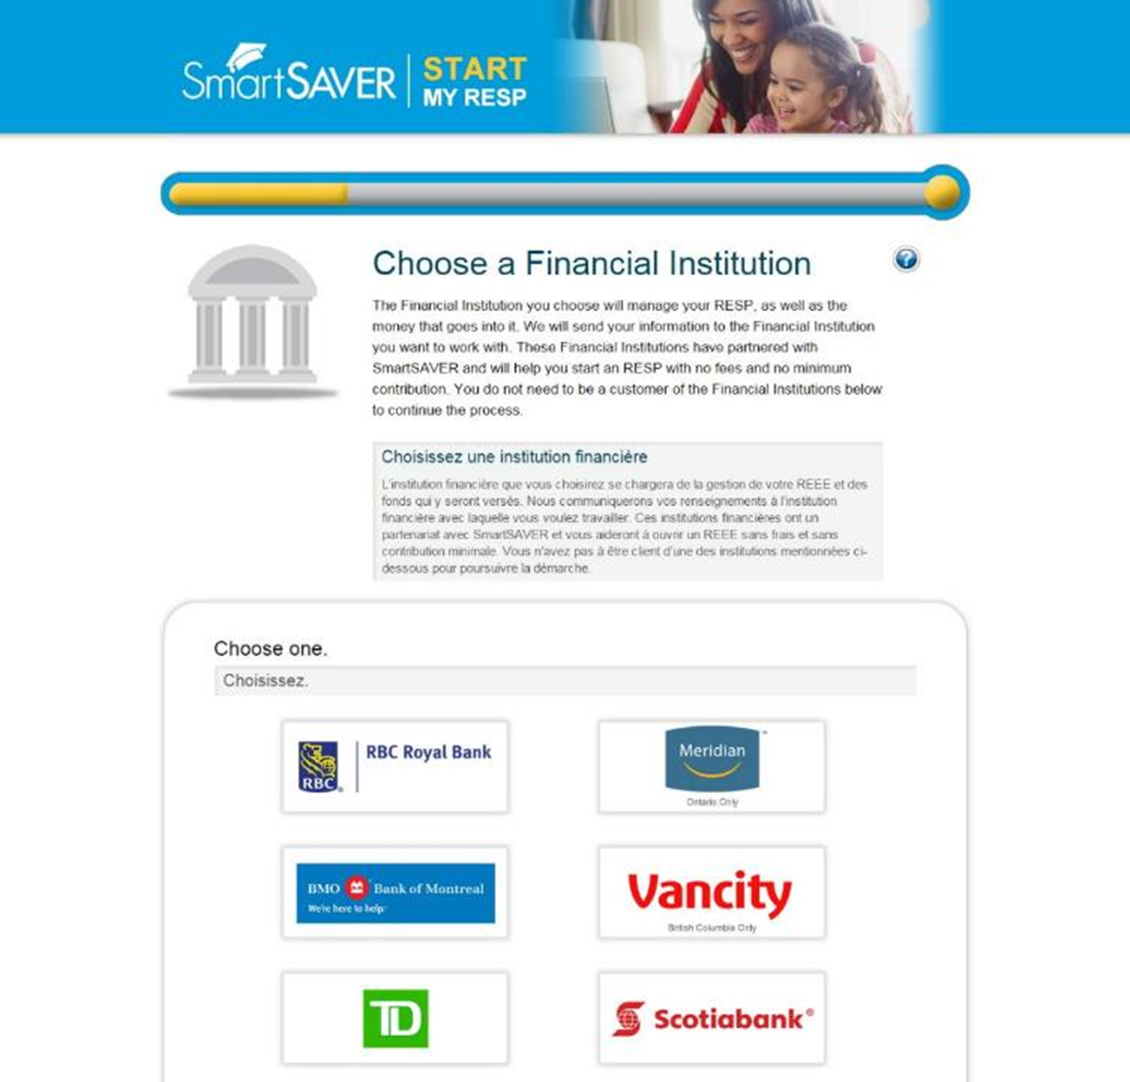
Notes:
SmartSAVER’s user-friendly ‘Start My RESP’ application takes less than 10 minutes to complete and is supported in five languages: English, French, Spanish, Mandarin and Punjabi.
BMO, RBC Royal Bank, Scotiabank, TD Canada Trust and 2 credit unions, Meridian and Vancity-British Columbia have come together to help. Each has committed to establish RESPs with no fees and no minimum contribution.

Slide 9
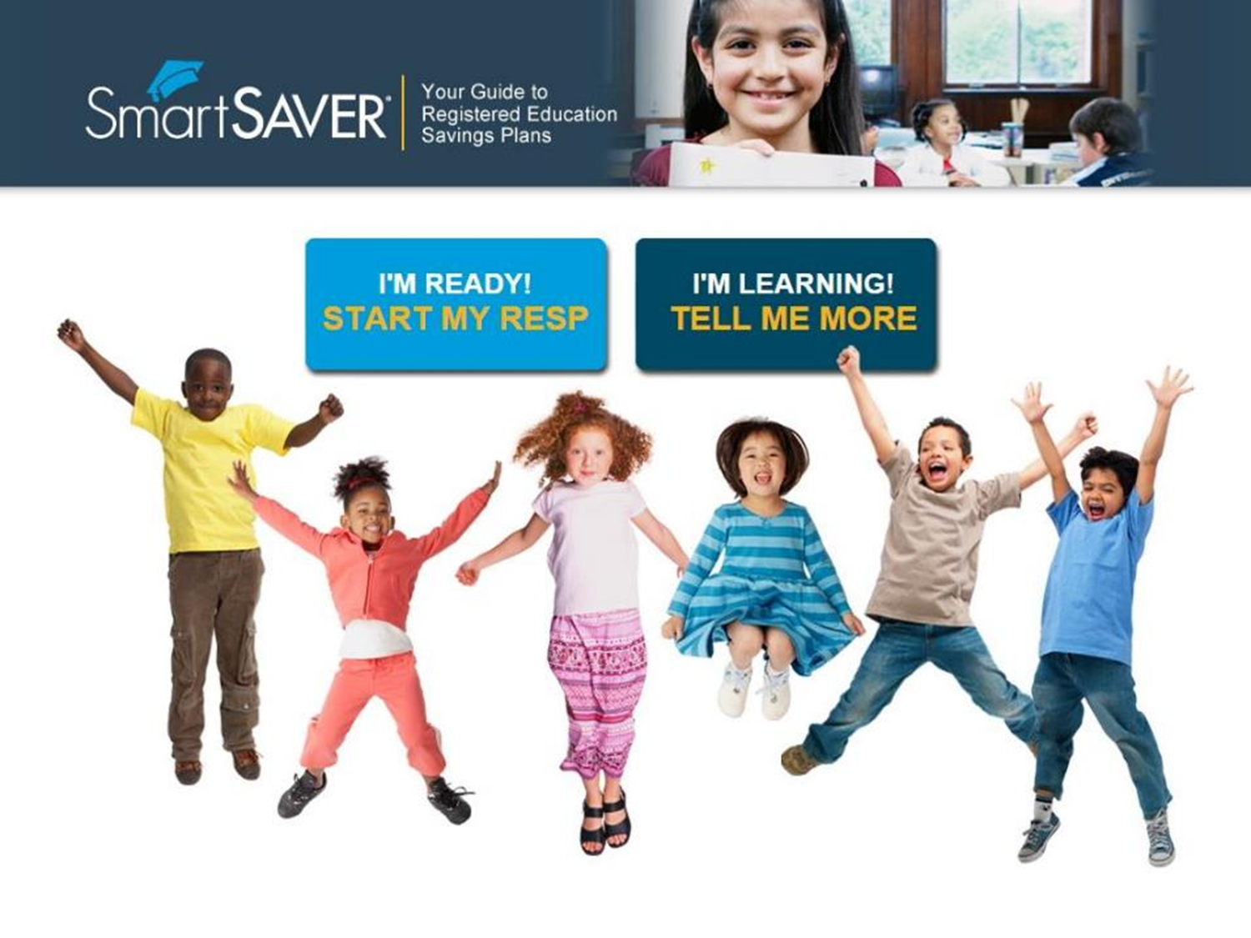
www.StartMyRESP.ca/CLBNiagaraNiagaraCL
https://www.smartsaver.org/startmyresp//?CLBNiagara
Notes:
Help families to access SmartSAVER’s new online application for the Canada Learning Bond – a tool called ‘Start My RESP’.
SmartSAVER and Start My RESP address some of the biggest enrolment challenges families face by clarifying product education and making the application process quicker and easier to understand.

Slide 10
SmartSAVER COMMUNITY INCENTIVE PROGRAM
Niagara Region received a unique URL (www.StartMyRESP.ca/CLBNiagara)
URL will track applications
Receive federal statistics quarterly to measure successes
SmartSAVER will provide monthly updates on progress and issue financial rewards for each child registered
$25 for every child registered
through our URL
40% goal by December 2016
Notes:
Bringing money into the community and for the United Way
Since July to April 338 children have registered through our link raising almost $10,000 for Niagara Region’s UW campaign
It is a “win - win” situation.

Slide 11
WHY
WHY
IT WORKS
MOTIVATION
Establishing an RESP motivates a family to save.
When students feel that PSE is an option, they put
more effort into studies and are more likely to succeed.
Savings increase the likelihood of PSE attendance and persistence. Financing is key to completion.
Completion of studies drives employability, income and financial stability.
COMMITMENT
PERSISTANCE
EMPLOYABILITY
Notes:
Extensive research demonstrates that establishing savings for lower-income kids’ future education makes a difference in their educational success.

Slide 12
CANADA EDUCATION SAVINGS GRANT
< $44,701
Notes:
The Canada Education Savings Grant is a federal grant that adds more money to an RESP by matching a family’s contributions.
Everyone, regardless of income is eligible for some matching money, but the lower the family’s income the bigger the match.
The maximum lifetime limit is $7,200 in CESG per child.

Slide 13
WHY
IT WORKS
WHY
75%
of kids with savings attend post-secondary
50%
of kids without savings attend post-secondary
Source:
Statistics Canada and HRDC, “Access, persistence and financing: First results from the Postsecondary Education Participation Survey (PEPS)”, 2003
Notes:
Canadian research shows that youth who have some savings earmarked for their education are 50% more likely to participate in post-secondary education than those who have none.

Slide 14
DISPELLING
THE MYTHS
RESPs:
Are very flexible
Can be used for a wide range of post-secondary education and related expenses (textbooks, laptop, rent, etc.)
Can be opened by the primary caregiver, family member, or friend
Study Abroad
Part-time or full-time studies
Accredited educational organizations of all types
Apprenticeship Programs
Notes:
RESPs are very flexible:
Can be used to fund part-time as well as full-time studies, in Canada or abroad in a wide range of qualified educational programs…not just traditional college or university programs. Can be used for related expenses as well, e.g. textbooks, laptop, etc.
It can stay open for 36 years and be used any time within that time frame.
An RESP can be opened by a parent, a relative, public caregiver or even a friend.
The person opening the account will always require the child’s SIN and the primary caregiver’s SIN.

Slide 15
BARRIERS
TO UP-TAKE
Lack of awareness
No SIN # or birth certificate
Intimated by banking process or
opening an RESP
2
3
Notes:
There are 3 main barriers to enrolment in RESPs and the Canada Learning Bond.
Low awareness
Little product education
Complicated application process:
An RESP requires social insurance numbers for both the parent and the child
Getting a social insurance number for a child requires a birth certificate
Getting an RESP and a social insurance number can be free. A birth certificate costs money. Community Care of St.Catharines and Thorold will help get and pay for a child’s birth certificate.

Slide 16
Notes:
What community organizations can do to help families get started:
Facilitate SIN registration
Access multimedia information in 16 languages at SmartSAVER.org
Encourage families to apply for their Canada Learning Bond
5 RESP providers in Ontario to choose from
All participating institutions offer RESPs with no start-up fee, no annual fee and no minimum contribution requirement

Slide 17
www.StartMyRESP.ca/CLBNiagara
Jess from St. Catharines
Notes:
The best way to help families is to make sure they hear about this information through people they know and trust – like you!

