Slide 1
Niagara Prosperity Initiative
Niagara Employment Network
June 8, 2016
Notes:
Introductions

Slide 2

Agenda
Niagara Prosperity Initiative (NPI) Purpose & Overview
Niagara Poverty Reduction Network (NPRN)
Mapping Tool
Measuring Impact

Slide 3
Definitions of Poverty
Condition of Poverty | Definition | Poverty Reduction Goal
Absolute Poverty | Lack of resources to meet the physical needs for survival. | Meet basic needs
Relative Poverty | Lack of resources to achieve a standard of living that allows people to participate and play a role that is deemed normative in the society to which they belong. | Equity / Parity with others
Poverty as Dependence | Lack of assets needed to meet one's needs on a sustainable basis. | Autonomy
Poverty as Exclusion | Processes of deprivation and marginalization that isolate people from the social and economic activities of society. | Inclusion
Poverty as Capabilities Deprivation | Lack of resources, capabilities, choices, security and power necessary for the enjoyment of an adequate standard of living, and other civil, economic, political, and social rights. | Human Development
Poverty as Presence of Inhibitors | Presence of conditions that act as a barrier to prosperity, such as the presence of abuse, addiction, poor health, hunger etc. | Human Development
Notes:
Chart taken from “A Compendium of Poverty Reduction Strategies and Framework’ Copyright © 2009 Tamarack – An Institute for Community Engagement
shttp://tamarackcommunity.ca/downloads/vc/Poverty_Reduction_GL_042209.pdf – page 5
There are different ways of looking at poverty – Absolute – Relative – as Dependence – as Exclusion – as Capabilities Deprivation – or as Presence of Inhibitors . There is more to poverty than just lack of money!
But we use a number of different things to help us to quantify and define poverty. For example, we know that individuals in need of social services have to meet some threshold of poverty defined by their low income.

Slide 4
Poverty is
Lacking the resources needed to meet the physical needs for survival
Lack of Equity / Parity with others
A condition of Dependence
Being deprived, marginalized and isolated from society
Not having the capability of leading a life that is valued
Living with abuse, addiction, poor health, hunger

Slide 5
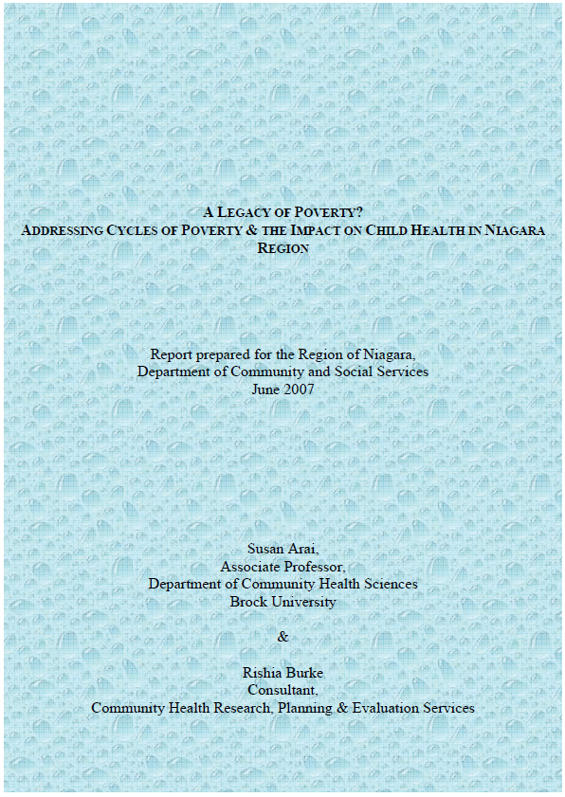
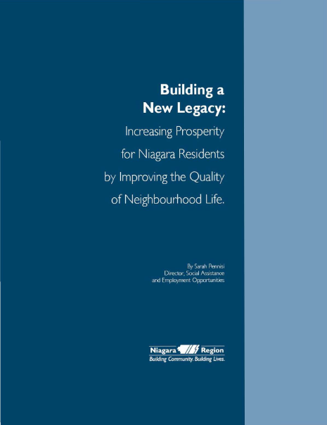
Background
The Niagara Prosperity Initiative (NPI) began in 2008, when Niagara Regional Council approved $1.5 million in yearly investments to address poverty reduction initiatives in Niagara
Notes:
NPI follows the recommendations made in the report: “Legacy of Poverty? Addressing Cycles of Poverty & The Impact on Child Health in Niagara Region” released in 2007; and in 2011, the report was updated with “Building a New Legacy: Increasing Prosperity for Niagara Residents by Improving the Quality of Neighbourhood Life”, renewing the framework for annual NPI investment
The broad recommendations in these reports sets the context for funding initiatives. Projects must demonstrate how they address at least one of the following:
Reduce poverty through advocacy – Proposals to create opportunities for communities of practice to occur (such as community development activities; multi-sectoral agency collaborations, etc.) in order to improve service delivery.
Appropriate supports which address the broader determinants of health for adults – Proposals to offer meaningful engagement opportunities to enhance opportunities for social inclusion.
Mitigate the negative effects of low income on children and youth through programs and services – Proposals to show how projects will meaningfully engage people in poverty to address isolation and stigma.
Monitor our progress – Proposals to develop increased capacity and foster sustainable commitment from the community.

Slide 6
NPI Approach
  Use available data (poverty reports; mapping tool data)
  Listen to the community and use expert advice on how to address poverty; use the recommendations from the poverty reports
  Place the recommendations in a Request For Proposal (RFP) for the community to respond on how poverty will be addressed given funding
  Funding is allocated through a place-based approach – addressing poverty at the community/neighbourhood level
  Has an independent review committee decide on who receives funding
  Contracts a secretariat to manage the NPI contracts
  Employs a Convener to assist in collaboration efforts in the community
  Short-term Project evaluation to provide outcome data for ongoing investment
Notes:
In our experience, the tools, techniques, mechanisms are all interdependent elements necessary to move us from theory to action.

Slide 7
Niagara Prosperity Initiative
Goals:
  Create stronger and more prosperous neighbourhoods
  Improve engagement of people living in poverty
  Improve health for people living in poverty, and
  Create greater economic prosperity for individuals and their communities
Notes:
What are we trying to accomplish through this funding – what is NPI’s goals…
NPI is based on data and analysis and issues funding in a calculated manner in order to ensure that funding is appropriately distributed to the areas of need.

Slide 8
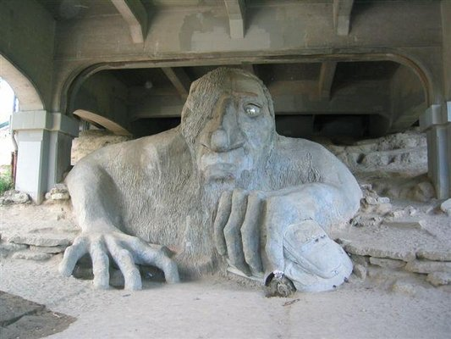
Notes:
So how can we help people in poverty to become more prosperous. NPI’s aim is to create better neighbourhoods, and help people improve their personal and social lives, physically, socially, and financially.
The Fremont Troll - Statue of a Troll gripping a Volkswagen.
The city of Seattle had a Neighbourhood Matching Fund – Jim Diers writes in his book ‘Neighbor Power’ – one of the first proposals was for a sculpture under a bridge in Seattle where there was illegal dumping and encampments, it was an unsightly section of the Fremont neighbourhood. So the people in the neighbourhood put in a proposal to build a sculpture under the bridge. There were three sculptures proposed – Larger than Life Construction Workers as tribute to the people who build the bridge; A large Throne (the area nickname was Hall of Giants); and a troll. Jim writes that when it came to voting he circled around the ballot boxes and voted repeatedly for the Construction Workers as it seemed the least objectionable. Cheating doesn’t pay and the troll won. When the mayor found out he told Jim “We can’t afford to maintain our streets. Don’t tell me we’re spending public funds on a troll”. The local newspaper wrote “If the people want bad art by majority vote, should public money be used to provide it?” It seemed that the powers that be didn’t want this built – but the neighbourhood did – they were daring in their conviction. As it was being built there was some early vandalism and the neighbours organized a troll patrol – on October 31st they had Trolloween – to promote they painted giant footprints up and down the street as though the troll had been walking around the neighbourhood.

Slide 9
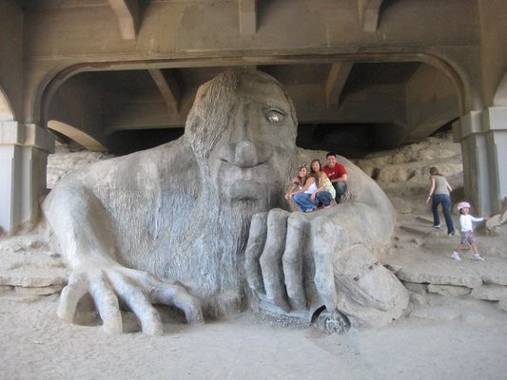
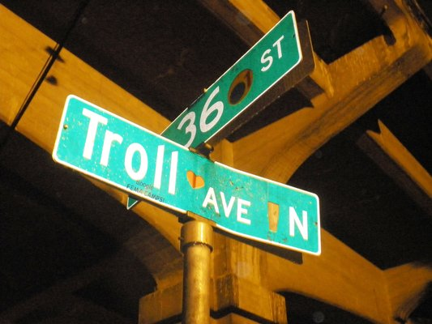
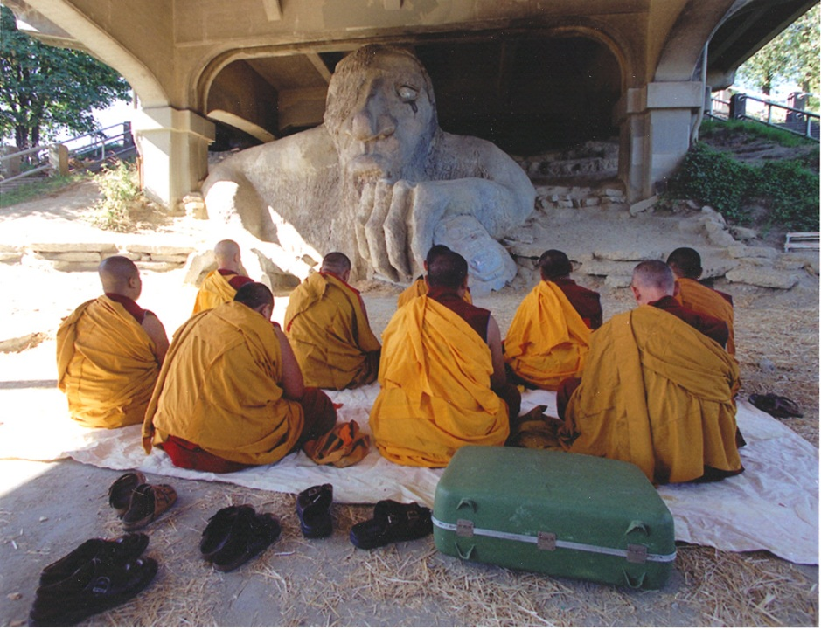
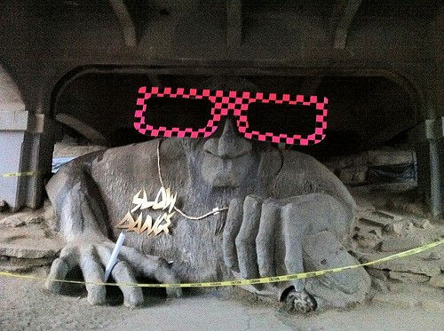
Notes:
Once it was finished the Freemont Troll was and is a huge success and a tourist attraction for Seattle. People come from around the world to have their picture taken with the troll. It has garnered praise by the same newspaper that originally slammed it – they wrote “time to eat troll, [the troll has] a sullen grace and monstrously droll charm”. With the tourism also came economic benefits to the neighbourhood and the space under the bridge was cleaned up.

Slide 10
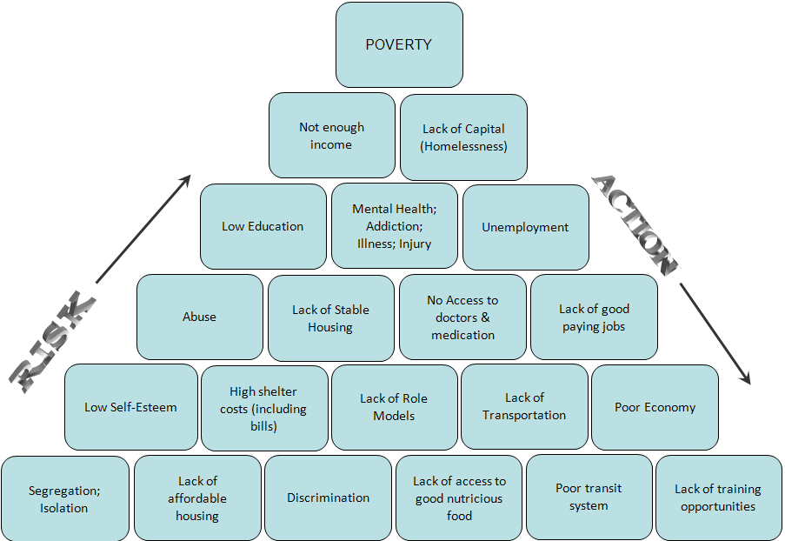
Notes:
Actions in Poverty Reduction/Elimination
There is no magic bullet for Poverty Reduction – would be great to give everyone a million dollars but that would still not solve all the issues.
Mostly systemic issues listed here – solutions are systemic as well although assistance with these issues can be provided on an individual basis (i.e. Lack of Transportation/Poor transit system means dealing with the system of transportation however providing people with bus passes until the larger issue is resolved will assist individuals with their immediate need)

Slide 11
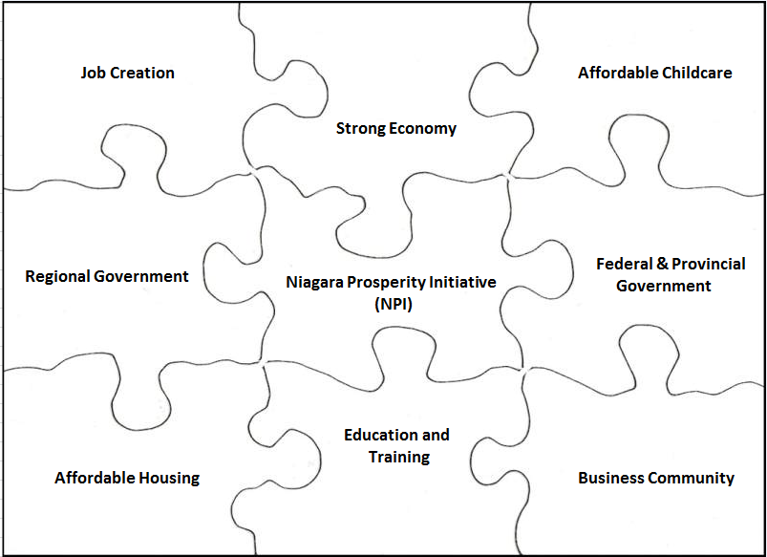
NPI is one piece of the puzzle
Notes:
Some of the barriers of measuring NPI effectiveness is that NPI is only one piece of the puzzle when it comes to poverty issues. If one of the puzzle pieces isn’t working well then all of the other pieces also suffer in what they can achieve. E.g. If the economy is poor this can affect the business community – if the business community isn’t doing well that can affect the taxes paid to government which affects availability of funding for programs such as NPI or affordable housing, childcare, education and training. Every piece has a role to play in the bigger picture and each has an impact on the other.

Slide 12
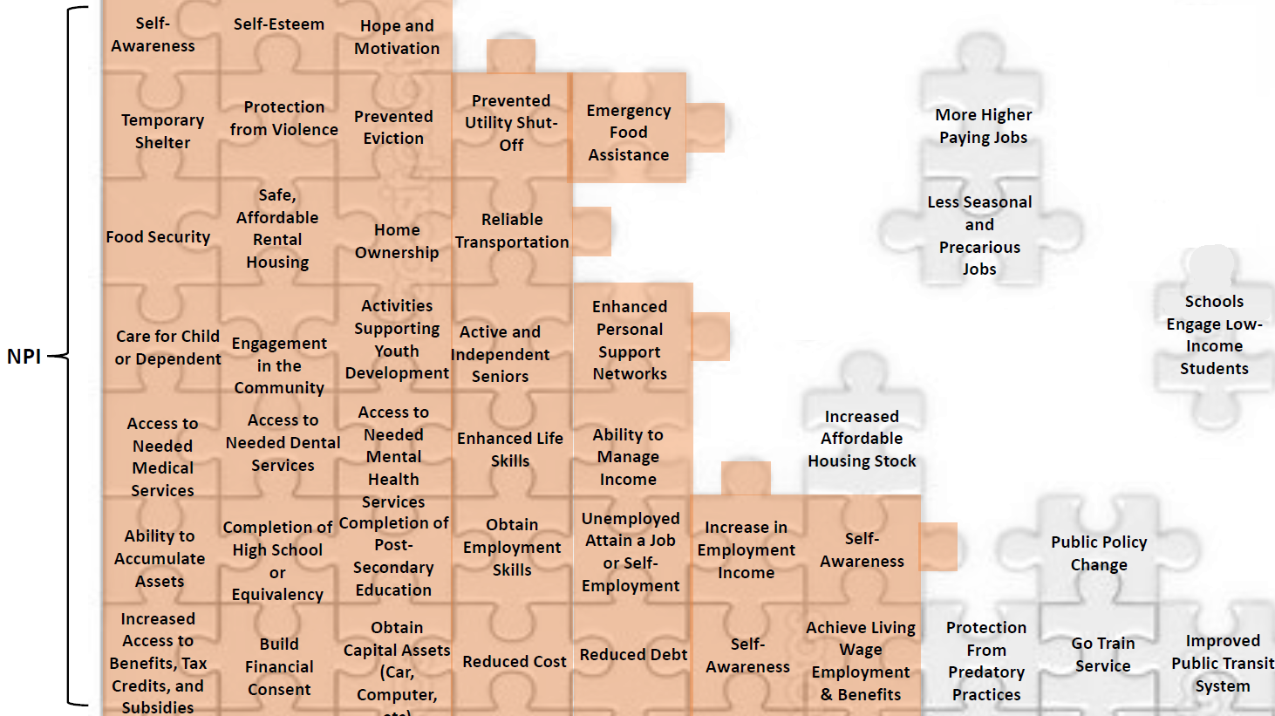
Tackling Poverty
Notes:
When looking at the impacts of NPI – we see that there are limitations to what the funding can do and that other factors are also needed in order to tackle poverty – including changes to funding formulas for Housing needs in Niagara, increased social assistance rates, higher paying jobs, improved transportation such as Go Train service. These are items beyond NPI’s means to address and requires advocacy. That is why it’s important to have advocacy groups such as NPRN.
However funding is necessary to make changes – what’s important is that we can show to the people making decisions on funding the impact that the work is doing in the community.

Slide 13

Putting the Pieces Together
Advocacy
Funding
Citizen Involvement
Community Development
Notes:
Putting the pieces together is more than just funding projects – its about advocacy for the things that funding can’t fix. By working together we can not only alleviate the effects of poverty but eliminate poverty.

Slide 14
What has been done to date
Notes:
Funding has been given for all kinds of programs: 318 projects contracted out to 83 different agencies over the last five years
In 2012 the percentage of the population living below the Low Income Measure before taxes was: 17.6 per cent (roughly 67,840 persons). If we were to give 67,840 people the $1.5 M directly it would add up to $22.11 per year or $1.84 per month.

Slide 15

Project Example
Notes:
How It Works
1. Enter a trip.
Specify your origin and destination using addresses, choosing from a list, or clicking on a map. Choose the days of the week you want to carpool. Or, you can choose to carpool on a specific date.
2. Search then adjust.
The service searches for other people who share your destination and time choices. It also checks if you can be picked up along someone’s way, or if you can pick someone else up.
3. Invite and accept.
Exchange invitations with your favorite matches.
4. Start Carpooling
Save money, reduce environmental impact, and build community.
Privacy
Your privacy is important to us. We do not share or sell our user lists to anyone. Your email address is only revealed to other commuters when an invitation to carpool is accepted -- it's up to you to determine compatibility.

Slide 16
Niagara Poverty Reduction Network

Slide 17

Niagara Poverty Reduction Network
Working collectively to wipe out poverty in Niagara through information sharing, changing attitudes, and compelling Niagara citizens to get involved and take action.
Notes:
NPRN is working collectively to reduce poverty in Niagara through information sharing, changing attitudes, and compelling Niagara citizens to get involved and take action.
NPRN provides leadership in informing and changing attitudes about poverty, sharing ideas, resources and information services to leverage, collaborate and maximize the opportunities for community engagement.

Slide 18
Niagara Poverty Reduction Network
Goals:
More residents, businesses and organizations know about poverty’s root causes
  Objective: Education and Information
  NPRN is the leading source of information on issues affecting poverty in Niagara
More residents, businesses and organizations are engaged in taking action to address root causes of poverty
  Objective: Supporting Collaboration
  Increase opportunities for collaboration to better address root causes of poverty
  Objective: Advocacy Work
  Influence decision makers to improve policy, program delivery and resource allocation to reduce poverty

Slide 19

Niagara Poverty Reduction Network
The NPRN has several associated working groups. These groups have representation from a wide-range of community organizations and meet regularly to work on relevant, poverty-related initiatives.
Basic Income Guarantee
Housing
Living Wage
Transportation
Notes:
As well as a Speaker’s school – they can come out and do a presentation What Do We Know About Poverty
And other groups – Community Developers, Community Gardens, MicroCredit – and helped organize Income Tax Clinics across the Region.

Slide 20
Mapping Tool – requirement for NPI funding

Slide 21
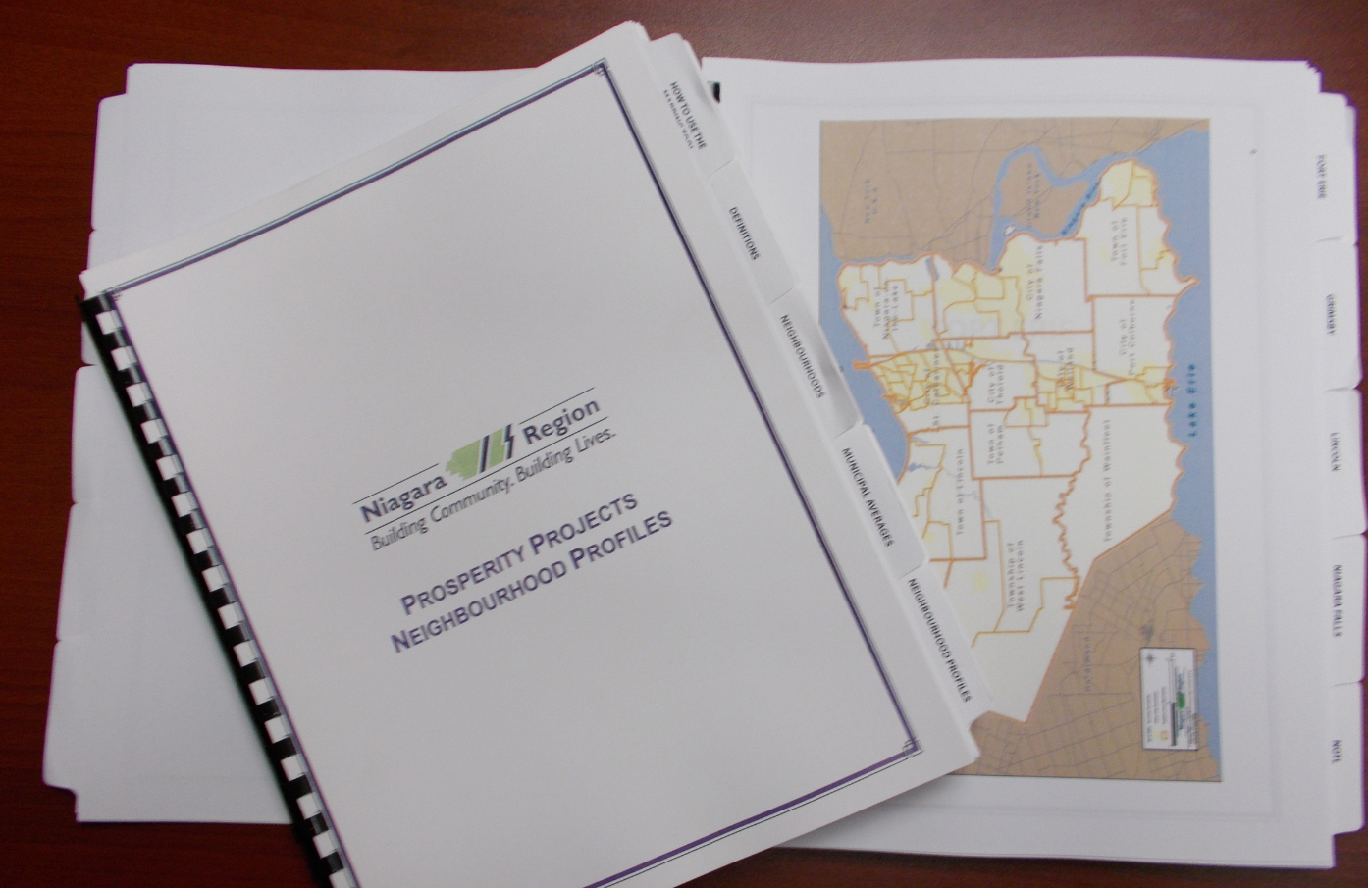
Building the Neighbourhood Profile
Identifying the Neighbourhoods
Notes:
One of the tools used in NPI is the Mapping Tool. This tool is used to help us identify where funding needs to be invested – both geographically and by issue. Every application for NPI funding needs to use the mapping tool to identify where and what their project will address. With $1.5M we know that we can’t eradicate poverty for all of Niagara but we can make coordinated and strategic impacts in the areas of need.
In 2009 the Mapping Tool was a paper document – approximately 100 pages. It defined Niagara’s neighbourhoods through work done in 2006 where an Ontario Early Years Data Analysis Coordinator facilitated community focus group sessions across the twelve municipalities. At these sessions participants looked at maps to determine neighbourhood boundaries – consensus was reached in all sessions and 74 neighbourhoods in Niagara were identified and named.

Slide 22
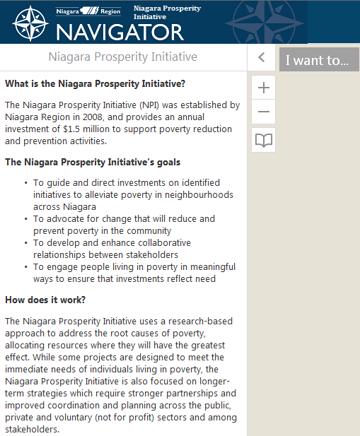
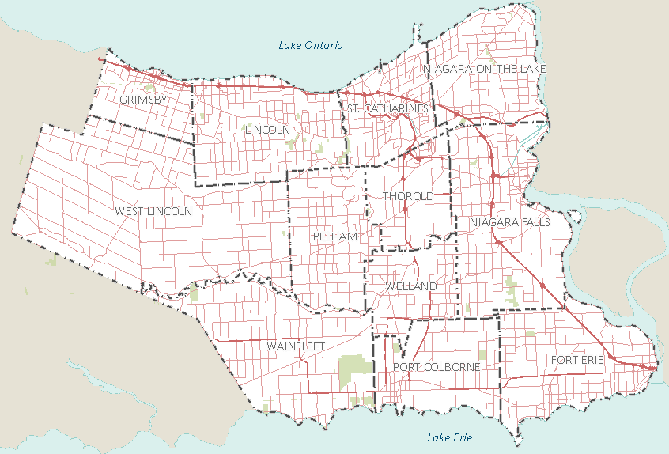
https://maps-beta.niagararegion.ca/Partner/?viewer=npi
Notes:
Mapping Tool is now available Online and is interactive – it can be accessed through the Region’s website

Slide 23
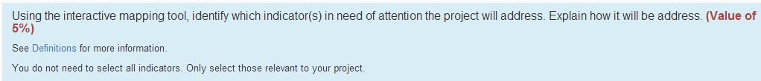
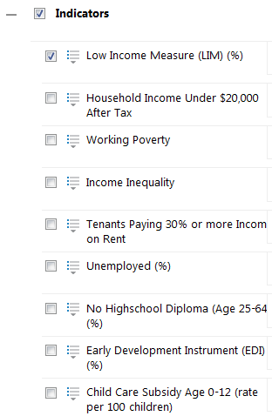

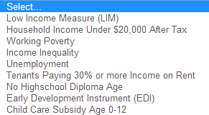
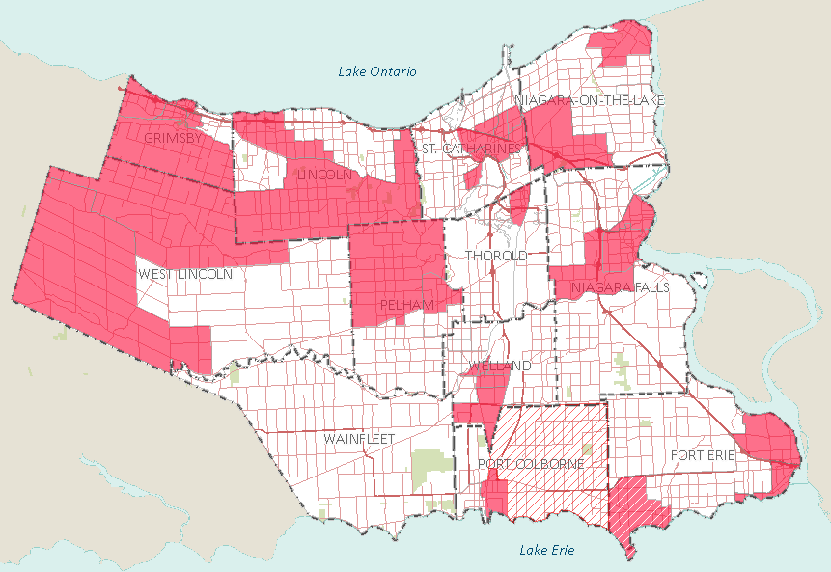

Notes:
Indicators were selected based on their availability at the neighbourhood level, accuracy, and relevancy – balanced and meaningful for community decision makers
Data bases used were pulled from Stats Canada; Public Health; and Community Services
Indicators are highlighted on the map by municipality or neighbourhood – based on whether the indicator is higher or worst off than the municipal average (e.g. In Fort Erie 13.16% of the population live below LIM, whereas the Fort Erie North neighbourhood has 20.29% of the population living below LIM – this means that Fort Erie North is an area that requires attention – funding should be focused in this neighbourhood.
In the RFP Application applicants must select the neighbourhoods and indicators that they will be addressing

Slide 24
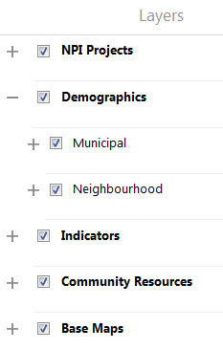
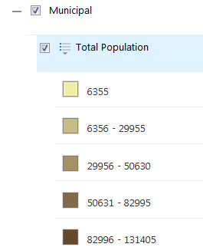
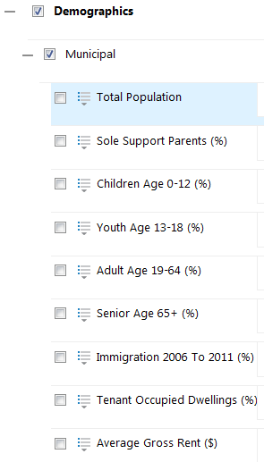
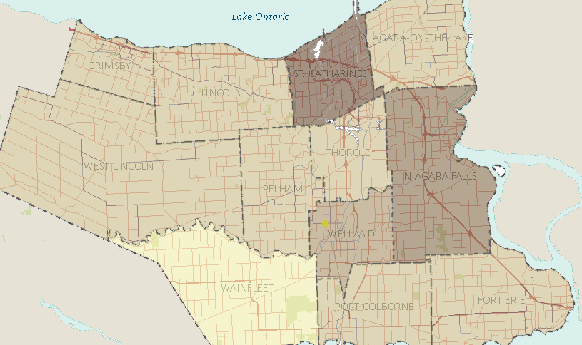
Notes:
Also available is Demographic data for Municipal and Neighbourhood
Data includes – Total Population, SSP, Children, etc…
By clicking on a Demographic the map colours change – darker the higher the number (scales are available by clicking on the drop down icon next to the description)

Slide 25
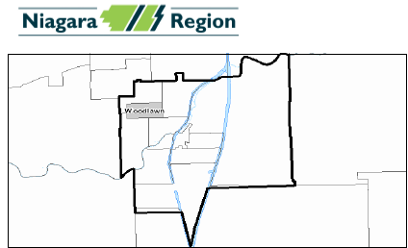
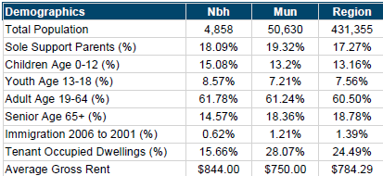
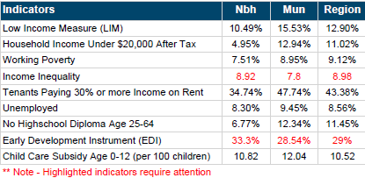
Notes:
Neighbourhood Profiles are available through the mapping tool.
The profile gives you a small map of the area – Demographic data and Indicator data is available at Regional, Municipal, and Neighbourhood levels
Under Indicators what is highlighted in RED means that it requires attention. So in this example EDI and Income inequality are two indicators that need to be addressed in this neighbourhood.

Slide 26
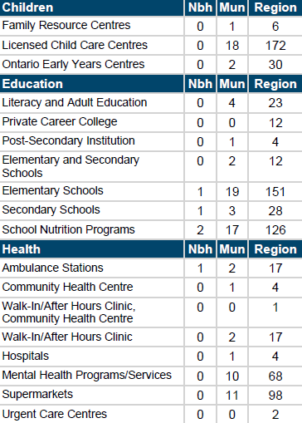
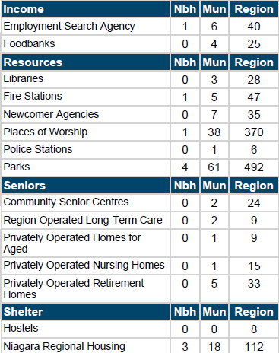
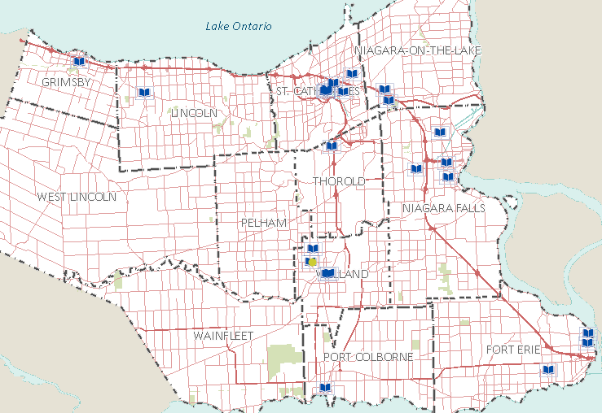
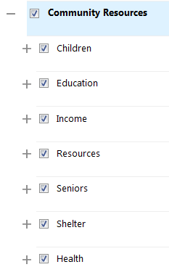

Notes:
Assets are also listed – and they appear in the map and in the neighbourhood profile

Slide 27
Measuring Impact

Slide 28
Project Scope
Notes:
We know what types of projects have been funded and have broken them down in the following categories:
Short Term Projects – one time issuance of a benefit (e.g. School backpack or Grocery voucher)
Long Term Projects – benefits from the project are long lasting for the individual (e.g. Educational program for children or Life Skills training for adults)
Neighbourhood Infrastructure – projects that provide added infrastructure to a neighbourhood that will last long after the project is completed (e.g. Community Gardens or Food-bank kitchen)
Community Development – projects that develops a communities capacity for change and improvements (e.g. volunteer development programs or awareness programs)
We can see in the chart that in 2008 the majority of projects were for Back to School backpacks, Winter Clothing, Grocery Vouchers, Utility Funds and Transportation passes – this was the initial ask when the back to school and winter clothing allowances were cancelled by the Province for people on assistance. The scope then changed to projects aimed at improving the lives of individuals by teaching skills or improving education.

Slide 29
Quantitative
In the application the applicant provides their estimated numbers – and after projects are completed we measure the actuals for the following:
  Children 0-12
  Youth 13-18
  Adults 19-64
  Seniors 65+
  Networks, links and/or partnerships formed in the community
  People directly or indirectly involved in civic engagement activities
  Jobs created and filled by people who live in poverty
  Units of Service Provided
Notes:
NPI also measures the number of people that is served by projects and some of the activities created in communities. We receive this information from the agencies providing the services
Units of Service Transportation Income/Employment Health/Activities Shelter Education Other

Slide 30
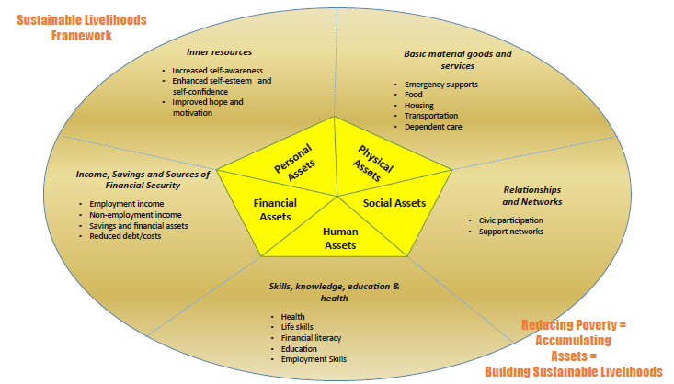
Notes:
NPI has adopted the Sustainable Livelihoods measures (dates back to the 1980s and has been used worldwide) as a measurement tool. Sustainable Livelihoods measures improvement in terms of individual and household assets in five asset areas: personal, social, human, financial and physical. Assets refer to the resources, capacities and entitlements that individuals and households can draw upon. NPI aims to enhance household and individual assets in each of these areas as these assets are associated with pathways out of poverty.

Slide 31


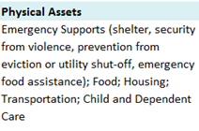
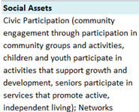

Project Outcomes - Assets
In the application we ask what Assets are the projects hoping to improve for people -

Slide 32
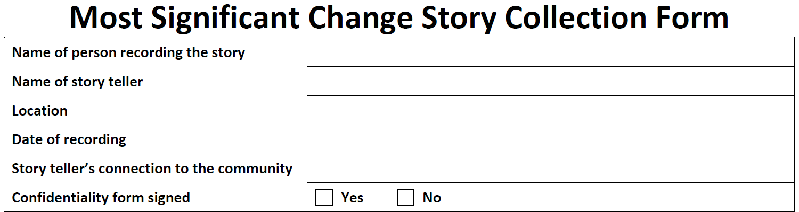
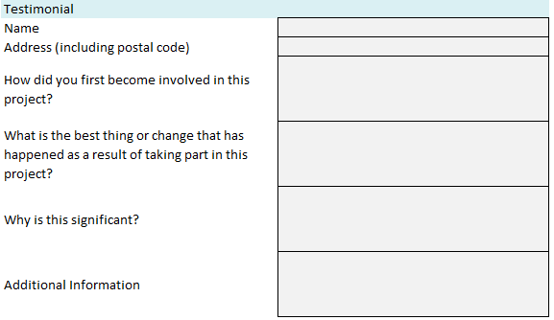
Project Outcomes - Assets
At the end of the project we request a % of Testimonials be completed using the Most Significant Change template.
Notes:
MSC was started in 1996 – used in third world countries to monitor the impact of programs in people’s lives
Funded agencies need to complete the template and provide the testimonial information.
• If you serve up to 40 clients, you will need to provide testimonials from 50% of the people served up to a total of 20 testimonials.
• If you serve over 41 clients, you will need to provide testimonials from 10% of the people served with a minimum of 20 testimonials and maximum of 40.
It is essential that you use the format below when collecting a testimonial. We have provided a form (Most Significant Change Form) along with this report for you to use when collecting testimonials. After you collect the forms, you will need to type the responses into the spaces below. The quality of your testimonials is important. Testimonials must be from people benefitting from the program and not staff or those implementing the program.

Slide 33
Project Outcomes - Assets
From the Testimonials an analysis is completed to look for the frequency that increases in Asset Types are mentioned
Example: “I got involved with the project when we were not getting enough food because it was expensive. I like this project because it showed me how to cook different foods and vegetables and I know that vegetables are the best foods to eat. These classes are important to me because I like being around people and not being alone.” From this testimonial we were able to pull out some outcomes -
  Increasing household income/decreasing cost of basic needs
  Increased food security
  Enhanced life skill
  Enhanced personal support networks
This is done by Project, by Municipality and by Neighbourhood
Notes:
The analysis is completed by a third party assessor. They go through all of the testimonials and check-off how many times one of the assets is improved.

Slide 34
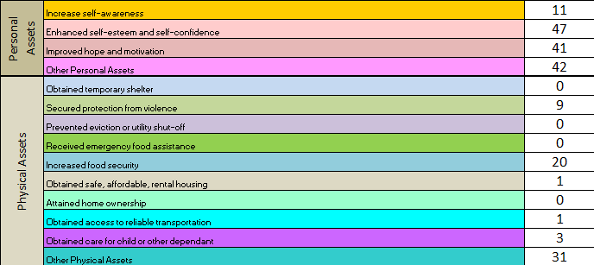
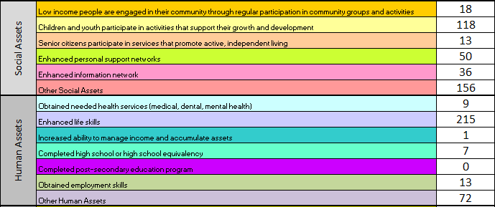
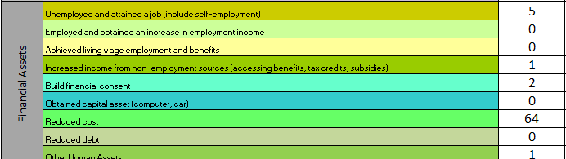
Testimonials mined for Assets Building
Notes:
These are then measured by funding cycle.

Slide 35
Notes:
By year (Funding Cycle)

Slide 36
Project Review
All of the projects that received funding are reviewed by asking the following questions:
  Did the project deliver the approved programs and services as per the approved objectives?
  Did the project meet the targets they said they were going to meet: # of people served; # of Networks, links and/or partnerships formed in the community; # of people directly or indirectly involved in civic engagement activities; # of Jobs created and filled by people who live in poverty?
  Did they stay within their approved budget?
  Did they pass the site/program visit/review?
  Did they meet all of the contractual obligations such as sending in financial and program information?

Slide 37
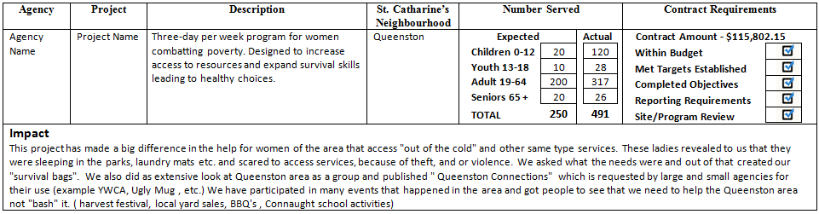
Example of Project Review
Notes:
From this information we create Project review scorecards. These Project Reviews are incorporated in Council Reports. They include agency, project name & description, municipality & neighbourhood, number served, contract requirements (meet or unmet), and an impact statement.

Slide 38
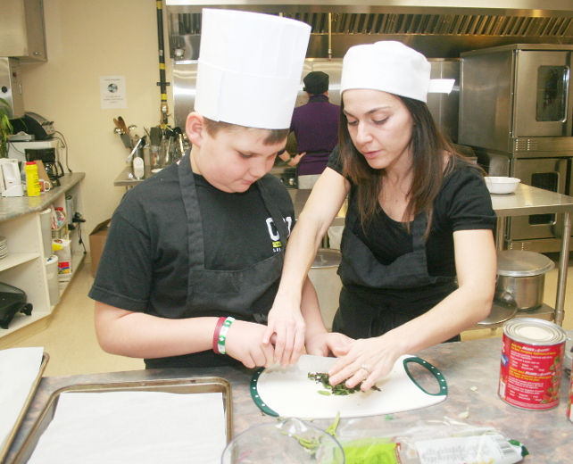
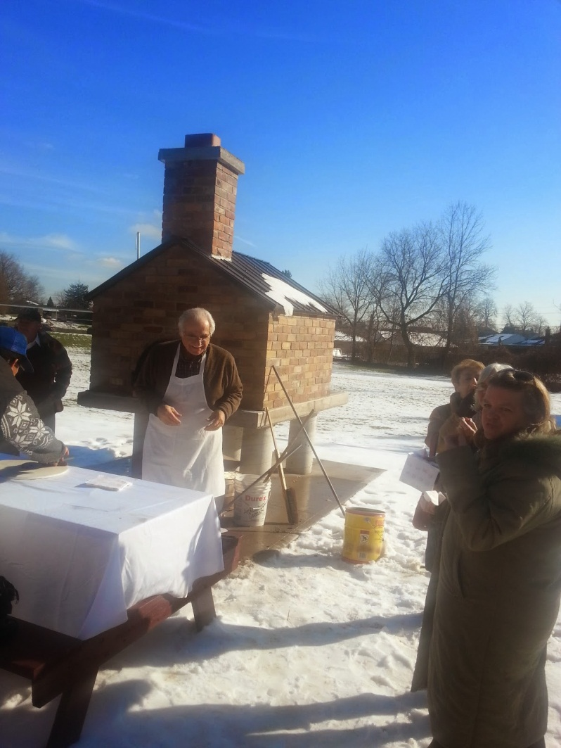
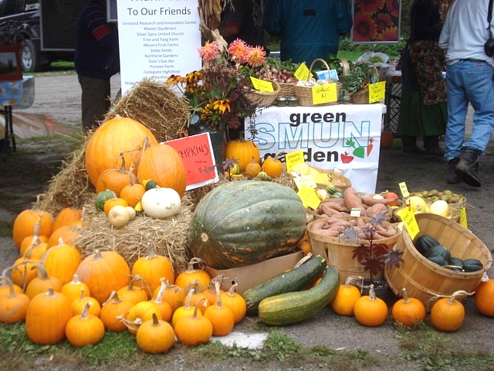
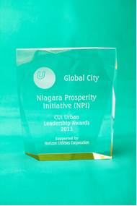
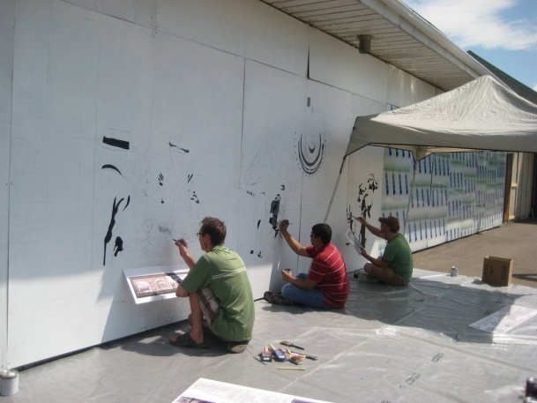
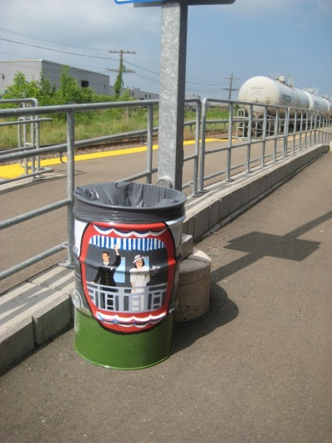
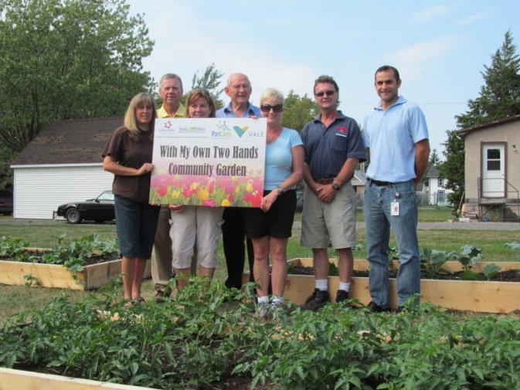
Notes:
In 2013 NPI was given the Urban Leadership Prosperity and Renewal award from the Canadian Urban Institute.
We didn’t do this to win awards but it is nice to be recognized by a national institution.

Slide 39
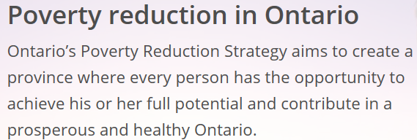
Ontario’s Poverty Reduction Strategy
We are currently working with the Province of Ontario in understanding shared measurements
Funding is available through the Local Poverty Reduction Fund - $50 million, six-year initiative created to support innovative, community-driven projects that measurably improve the lives of those most affected by poverty.

